Slide 1
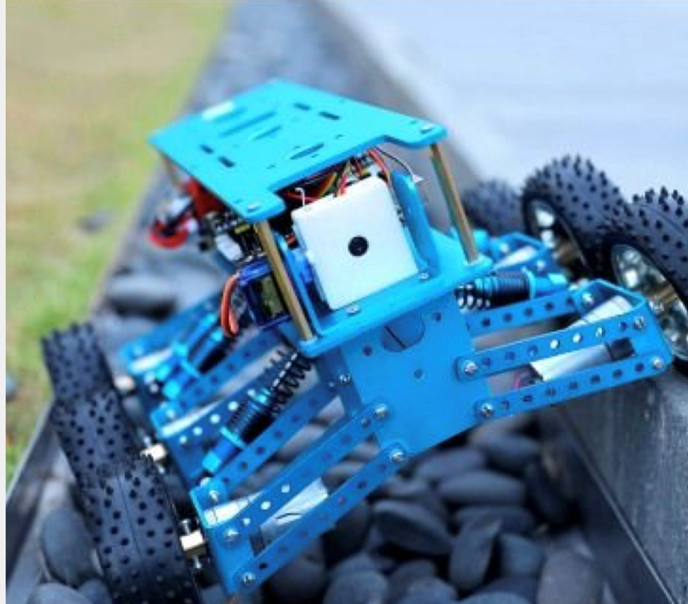
The Design of a Ground Rover for Geographical Acquisition
Favour Dada Rm 1088 May 13th, 2019.
Jesudara Omidokun EACM
Aduralere Sulaiman

